Slide 1
Spotify Exploratory Data Analysis
Team Gitting It Done

Slide 2
Background & Research Questions
“In 2010, only 35 percent of internet users streamed music. Pandora and YouTube were the dominant players. By 2019, music streaming grew to 82 percent.” (https://musicwatchinc.com/blog/ten-years-after-music-consumers-and-the-decade-of-the-teens/)
Spotify launched in 2008 (https://newsroom.spotify.com/company-info/). Its platform and those of competitors have greatly impacted the way we listen to music.
Knowing that how we listen to music has changed, we wondered if what we listen to/what kind of music being made has changed. We decided to investigate genre in the decade prior to the COVID-19 pandemic. We focused around one central question: What are some underlying trends in the music industry by genre? More specifically:
What is the average duration of songs based on genre? Is the difference between each average and the overall average statistically significant?
Are specific music keys favored? Has this changed over the 2010s? What does variation in the data look like by genre?
How much do acousticness, liveness, tempo, and valence vary between genres? How did they change by genre over the 2010 decade?
Does competition affect song popularity?

Slide 3
Data Exploration
We utilized kaggle.com to find an existing Spotify dataset that:
Was sufficiently large & complete
Had a high usability rating
Was categorized as being good for learning by other users
We found a dataset called “30,000 Spotify Songs” (https://www.kaggle.com/datasets/joebeachcapital/30000-spotify-songs/) with the following characteristics:
It was extracted from Spotify’s API using “spotifyr” (https://www.rcharlie.com/spotifyr/)
It contains about 5,000 songs from each of six genres (EDM, Latin, Pop, R&B, Rap, Rock), classified by the assigned genre of the playlist in which the song was found
Its songs were released as far back as March 1957 and as recent as January 2020
Notes:
Curtis

Slide 4
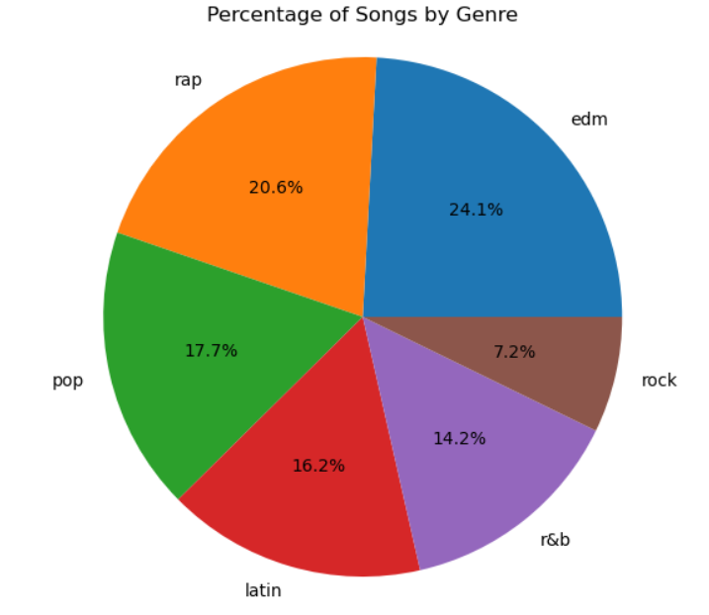
DataFrame Cleaning
To clean the data, we performed the following steps:
Dropped rows with empty columns
Dropped rows with incomplete date format
Dropped duplicates by:
Track ID (keeping the first)
By same artist and song (dropped all)
Narrowed dataset to include only 2010-2019
Original dataset: 32,833 rows
Final dataset: 16,046 rows
Genre breakdown of final dataset displayed to the right
Notes:
Elsie

Slide 5
Exploring song duration by genre

Slide 6
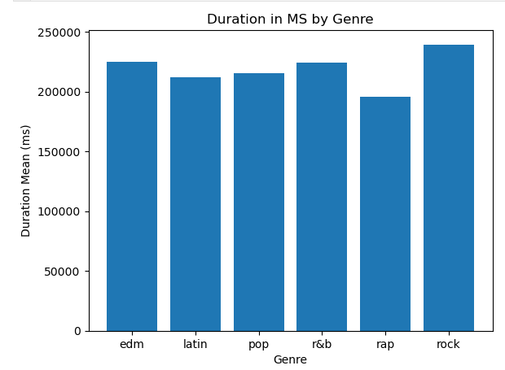
NN‘
Note:
ms is milliseconds; 1 ms is equivalent to 1/1,000th of a second, thus 1 minute is equivalent to 60,000 ms
The average song lengths vary between 195,935 to 239,443 ms, which is approximately 3:16 to 4:00 minutes.

Slide 7
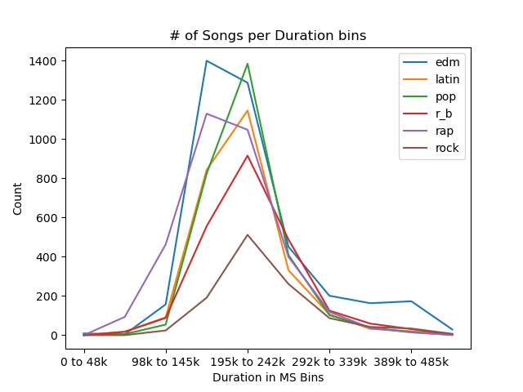
Note:
Over 80% of the songs in our data fall within two bins ranging from 146k to 242k ms.

Slide 8
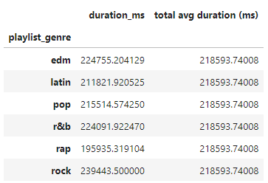
Hypothesis Testing
Null Hypothesis:
The average duration by genre is the same as the total average duration regardless of genre.
Alternative Hypothesis:
There is a statistical significance in the average duration of music by genre.
Chi-Square Test
Degree of freedom is 5.
P-value = 0.05
Critical Value = 11.070497693516351
Chi-Square = 4902.468755898275
Conclusion:
Since the chi-square value of 4902.5 exceeds the critical value of 11.0,
We conclude that difference in mean duration by genre compared to overall mean is statistically significant.

Slide 9
Exploring song keys over time & glimpsing at genre

Slide 10
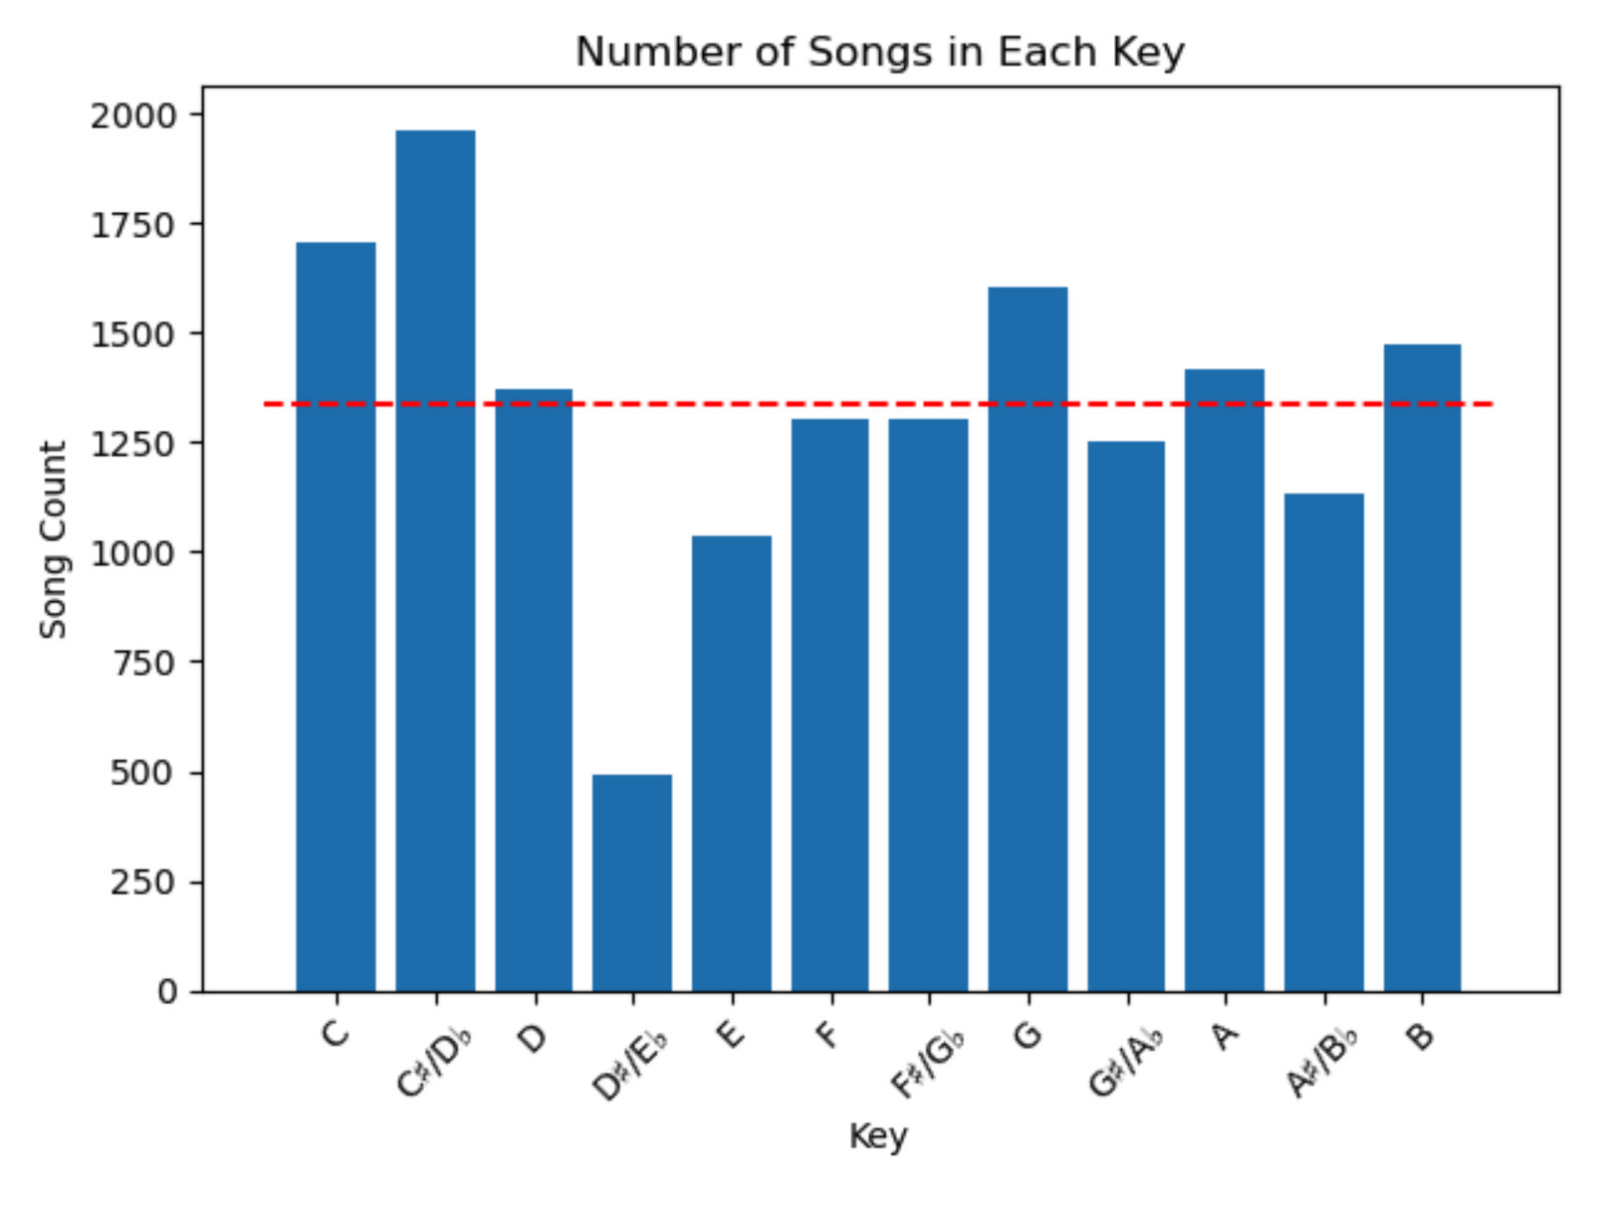
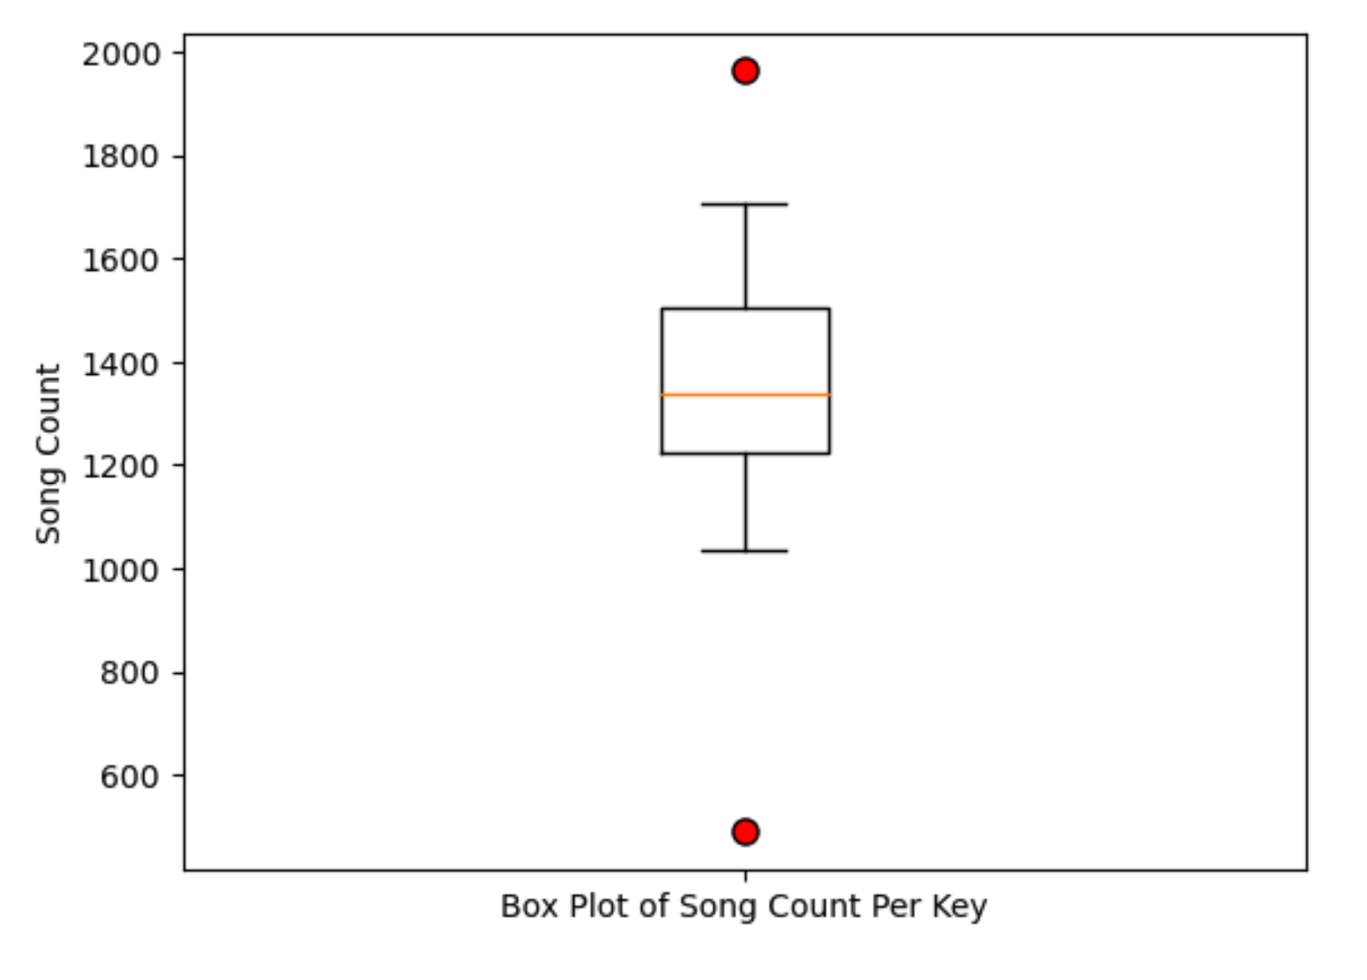
Starting with all songs in the dataset
All but two keys are “reasonably” distributed near the mean line.

Slide 11
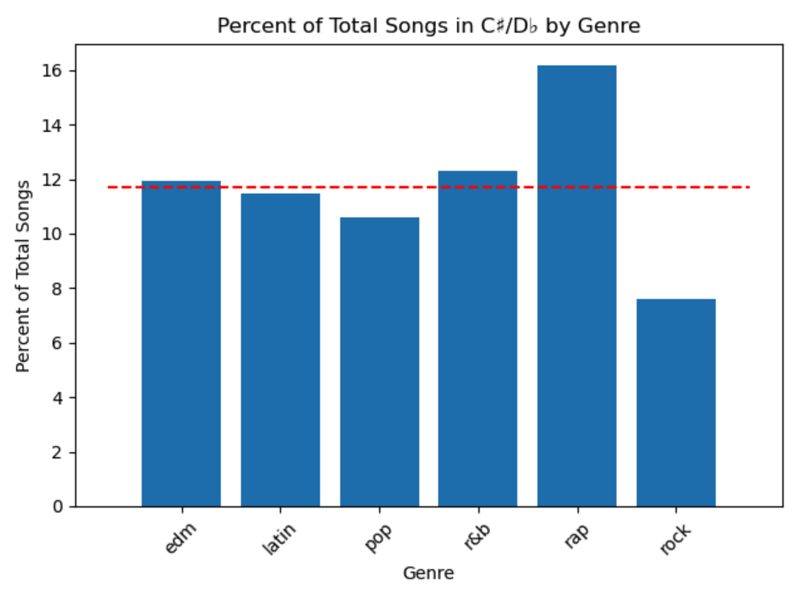
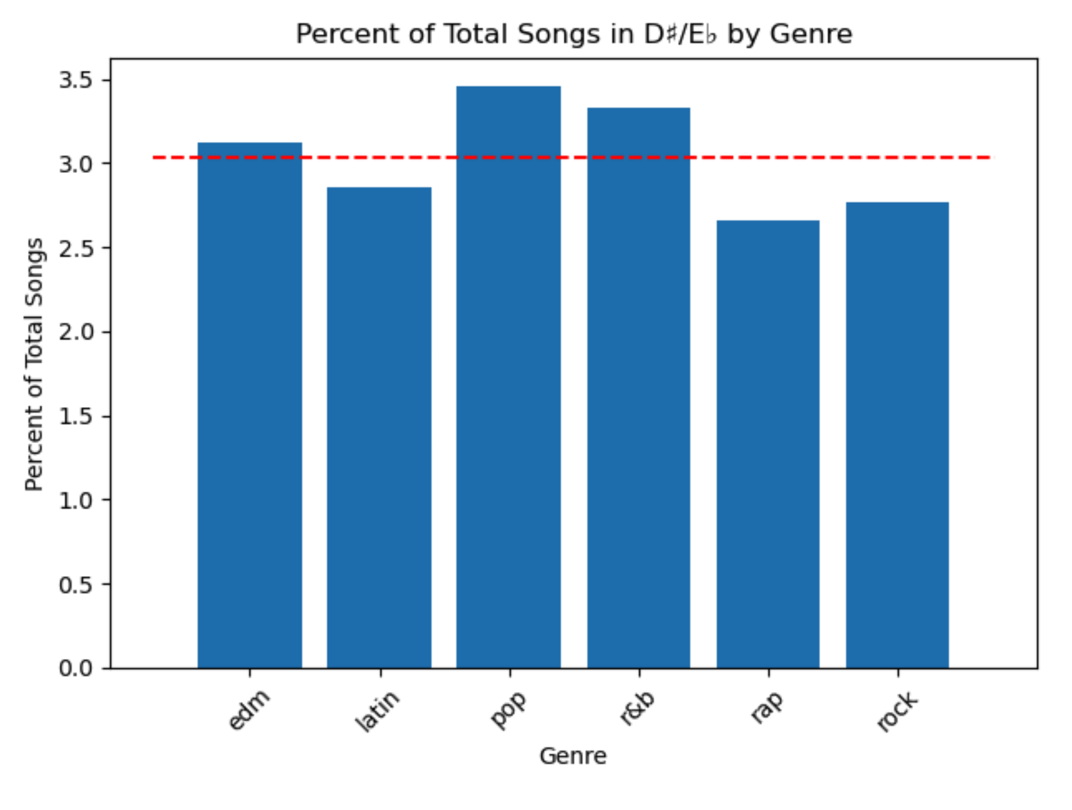
Investigating the outliers
Rap and Rock are outliers in this set
(boxplot not shown), but an overall average of 12% for this one key is responsible for its “over-representation” among all the keys.
There are no outliers in this set
(boxplot not shown), but an overall average of 3% for this one key is responsible for its “under-representation” among all the keys.

Slide 12
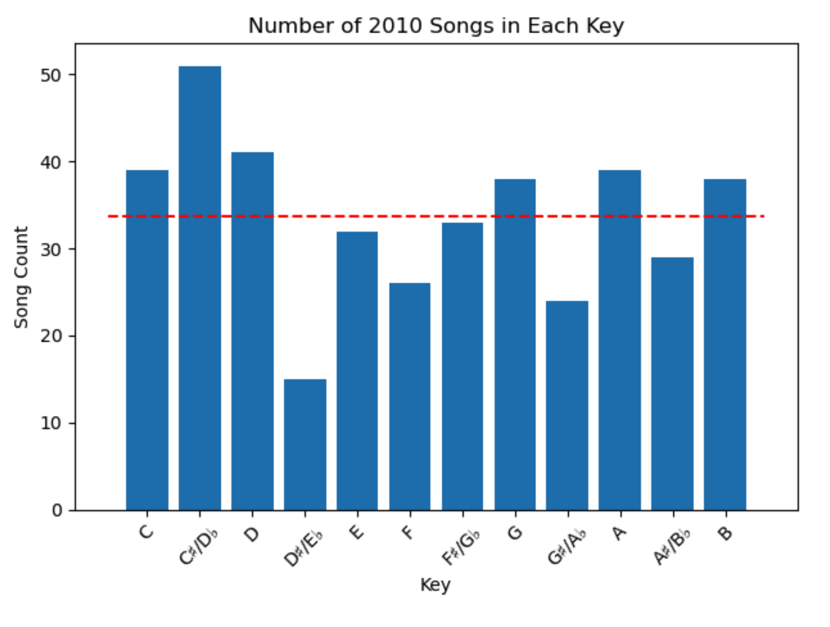
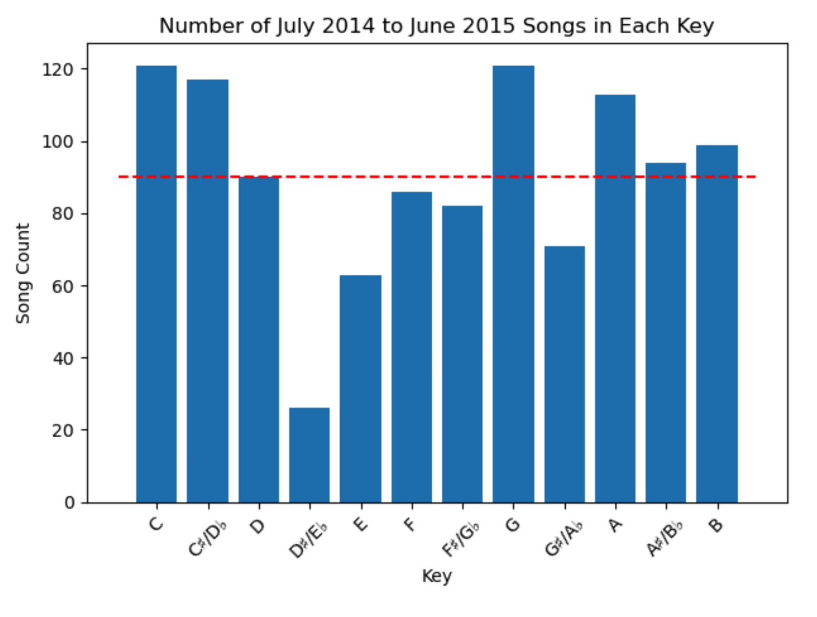
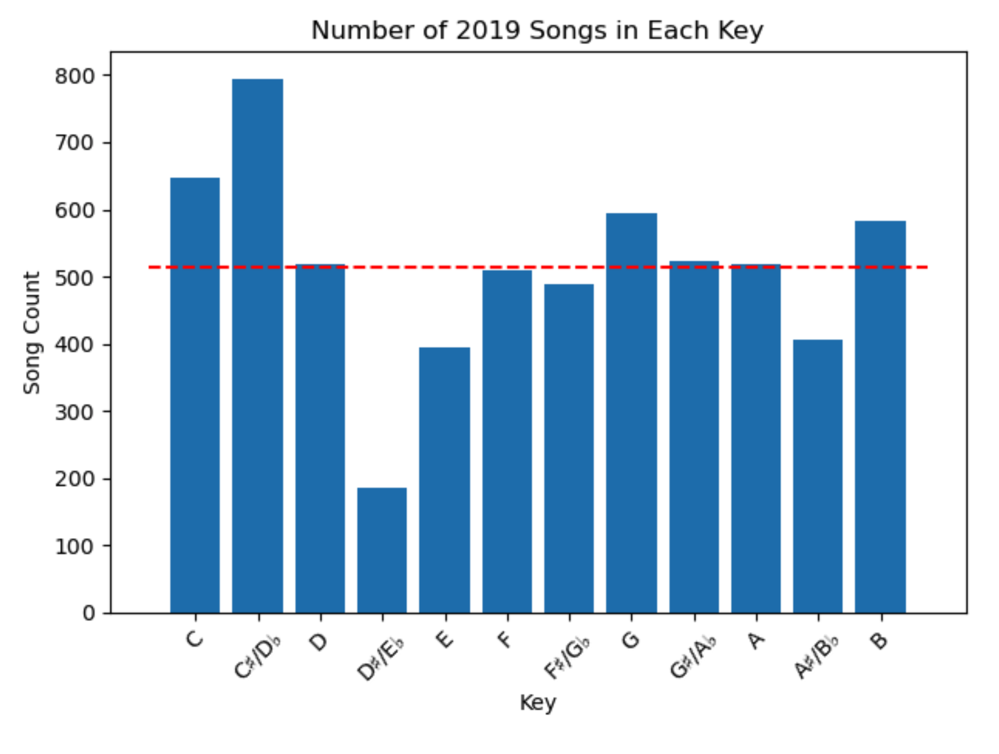
Charting key use through the decade
Note that the overall size count of this dataset filtered for 2019 offers a clue as to why it most closely matches the bar chart for the entire decade compared to the other two: it’s a bigger sample size.

Slide 13
Exploring genre characteristics over time

Slide 14
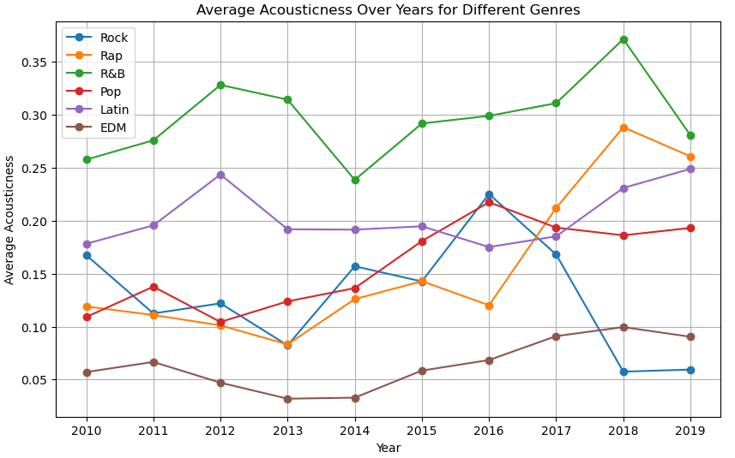
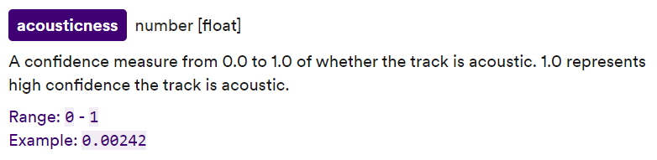
Minimum: 0.00004
Maximum: 0.932
Average: 0.1006
Highest IQR: R&B, 0.436
Lowest IQR: Rock, 0.0801 (EDM a close second: 0.0803)

Slide 15
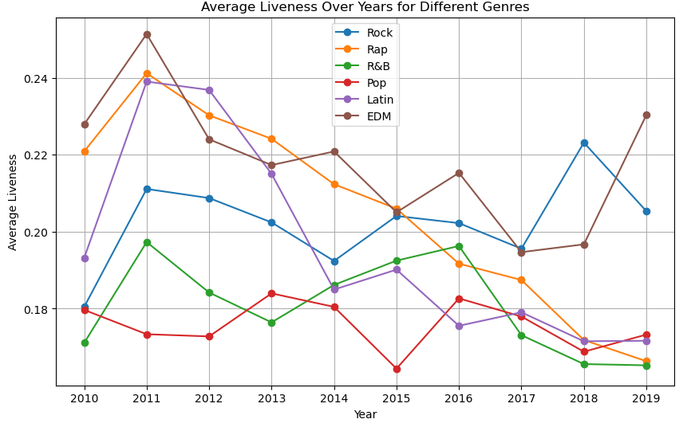
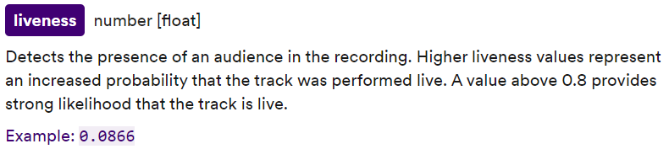
Minimum: 0.009
Maximum: 0.991
Average: 0.189
Highest IQR: EDM, 0.2163
Lowest IQR: R&B, 0.1077

Slide 16
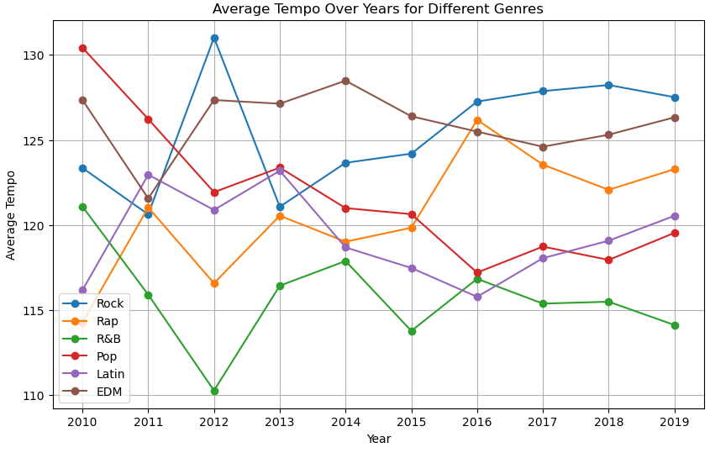
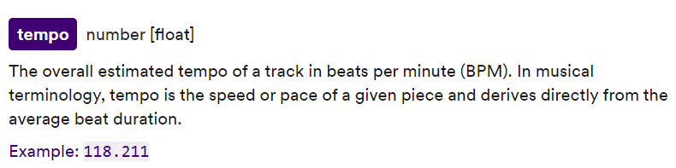
Minimum: 35.477
Maximum: 239.44
Average: 121.65
Highest IQR: Rap, 50.34
Lowest IQR: EDM, 4.155

Slide 17
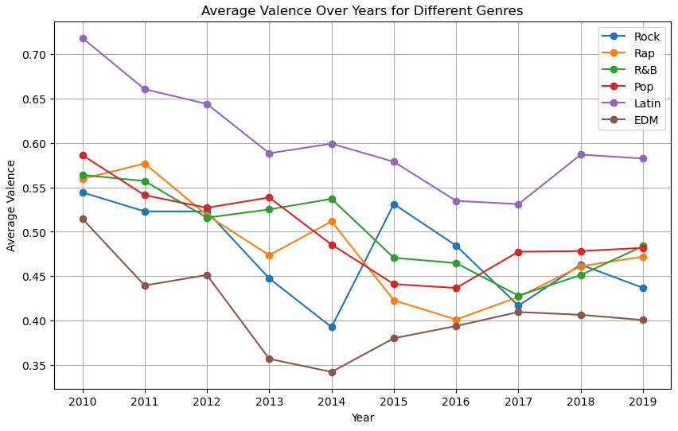
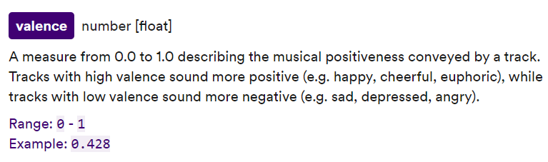
Minimum: 0.033
Maximum: 0.969
Average: 0.413
Highest IQR: Rock, .359
Lowest IQR: Pop, .325

Slide 18
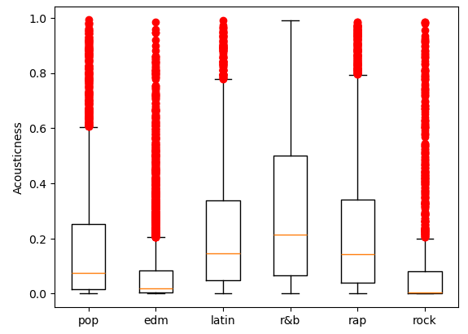
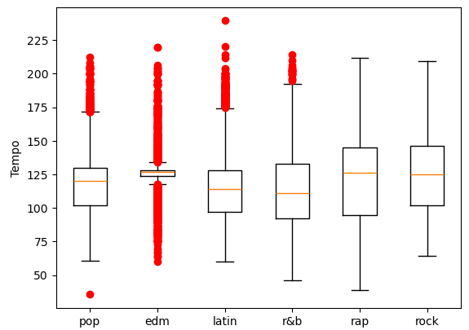
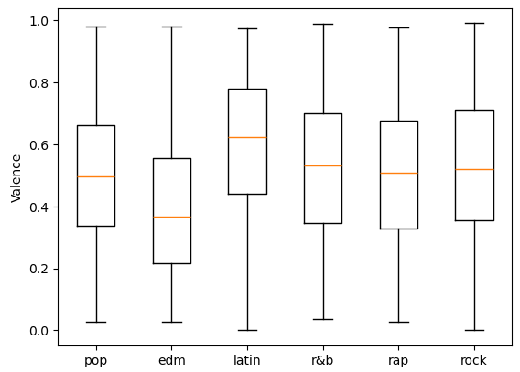
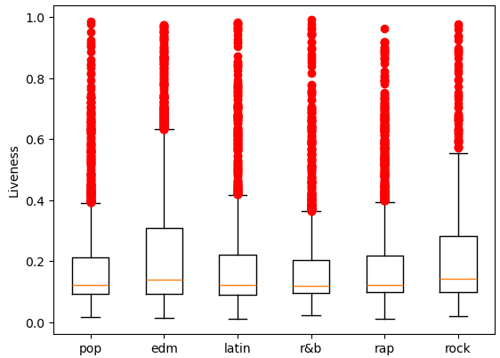

Slide 19
Exploring competition & track popularity over time

Slide 20
Background
Spotify´s “Popularity Index” is measured on a scale of 0 to 100 and takes into account three key factors:
Number of streams.
Stream date.
Frequency of streams.
While a high popularity index will make it more likely that a track is recommended to new listeners, it's not the only factor at play in Spotify´s algorithm.
A high popularity index will increase a track´s chance of being added to “Personalized Playlists.” These playlists are designed by Spotify´s algorithm and unique to each user.
Resource:
“https://twostorymelody.com/spotify-popularity-index/”, “What is the Spotify Popularity Index” by Marco Alexis.
Notes:
Rather than putting this in the conclusions, it could be talked about/mentioned here:
My original hypothesis is that track popularity could potentially be affected by the total amount of tracks released that same month. The Spotify Popularity Index is a 0-to-100 score that ranks how popular an artist is relative to other artists on Spotify.
During months with a high amount of track releases, listeners will have less time and energy to dedicate to each track. This will reduce the amount of saves a certain track receives, and how often it's streamed. These two factors directly affect track popularity.
I designed six graphs plotting total releases per month, and mean track popularity per month in 2010, 2015, and 2019. Based on the graphs alone, there appeared to be several instances where the months with the highest amount of track releases coincided with low average track popularity and vice versa.

Slide 21
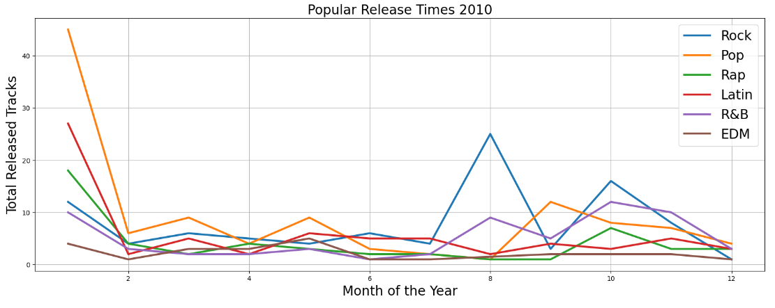
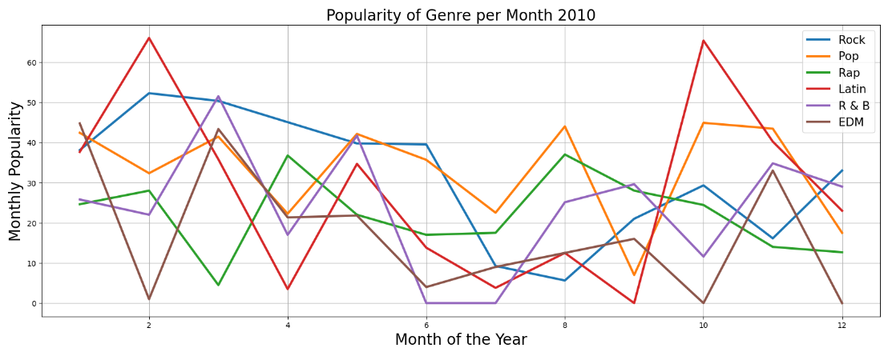

Slide 22
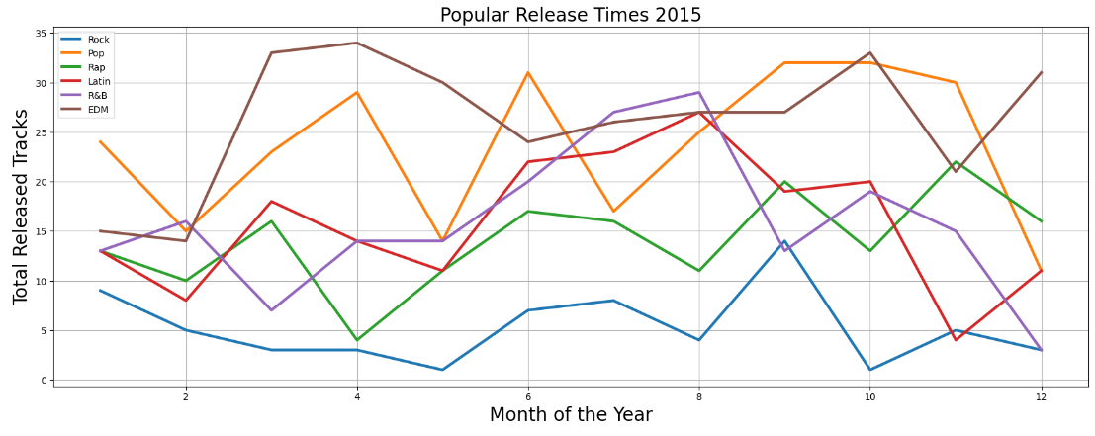
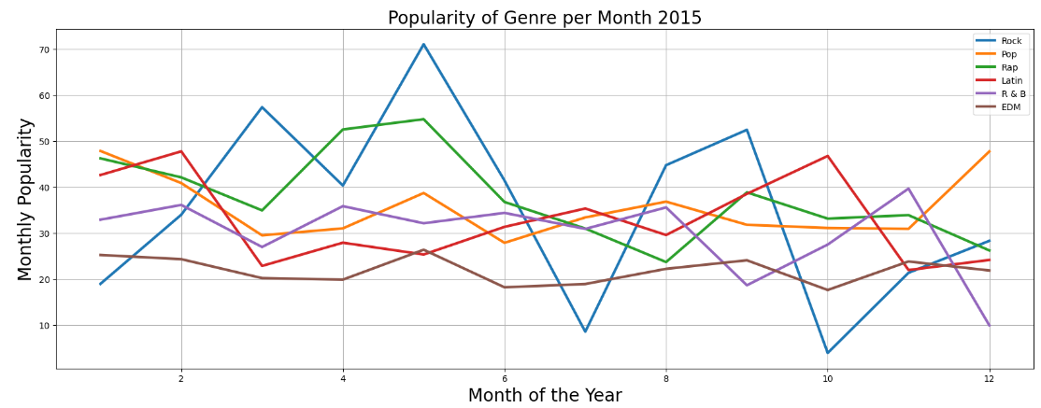

Slide 23
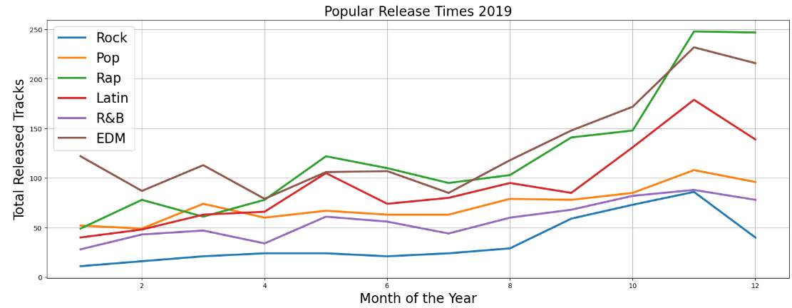
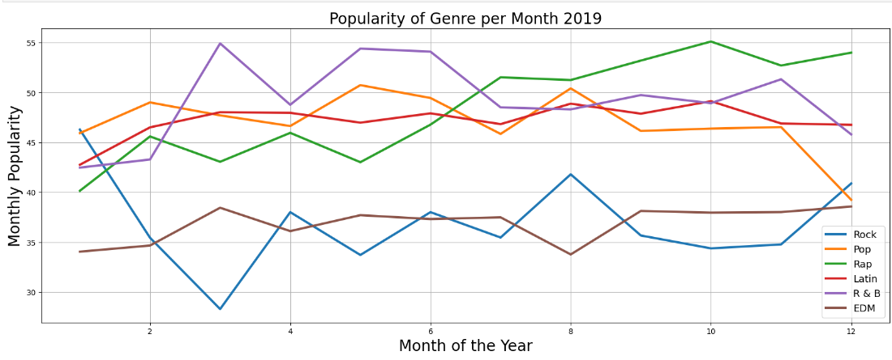

Slide 24
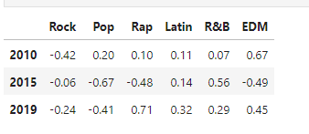

Slide 25
Overall findings

Slide 26
Conclusions
Song duration by genre:
The average song lengths across all six genres vary between 3:16 to 4:00 minutes.
Over 80% of the songs in our data fall within two bins ranging from 146k to 242k ms.
There is a statistically significant difference between the duration means by genre as compared to the overall mean of duration.
Song keys overall, over time, and a glimpse at genre:
For a majority of the songs over the decade, the music keys are pretty evenly represented.
C♯/D♭and D♯/E♭ are exceptions; the former is a bit over-represented and the latter a bit under-represented, and this is mostly independent of genre.
Key usage is fairly stable across the decade.

Slide 27
Conclusions (continued)
Genre characteristics over time:
Liveness of songs recordings decreased across all genres besides rock and edm.
Average tempo became more consistent over time for each genre, with less variation. between tempos year to year from 2016-2019 (Perhaps due to the growth of streaming service created playlists).
Valence decreased across genres from 2010-2014 with lows between 2014-2016, then slightly rose again and leveled out (similar to tempo) 2017-2019.
Competition and track popularity over time:
Track popularity does not appear to be affected by number of released tracks in that month.

